Slide 1

Loan Portfolio Review
A Detailed Performance & Risk Analysis (2007–2011)

Slide 2







What is this Project About?
Strategic Intent
Data Scope
Key Outcome
Designed to transform 39.7K raw application records into actionable intelligence for risk mitigation and capital growth.
Comprehensive analysis across 5 years of historical data, auditing ₹434.8M in funding and identifying regional hubs.
Identified a ₹48M revenue surplus and established a tiered risk model for future credit allocation strategies.

Slide 3



Core Performance Indicators
These metrics provide the heartbeat of our lending business. They tell us exactly how much we gave, how much we earned, and how much risk we took.
$ 434.8M
$ 482.7M
12.02%
1331%
$ 3.8M
TOTAL FUNDED
TOTAL RECEIVED
AVG INT RATE
AVG DTI
RECOVERIES

Slide 4

Growth Acceleration (2007-2011)
2007 ($2M)
2008 ($14.4M)
2009 ($46.4M)
2010 ($122.1M)
2011 ($260.5M)
Key Insight: Our loan volume exploded over five years. We went from ₹2.2M in 2007 to over ₹260M in 2011. This proves that market trust and demand for our loans are rising rapidly.

Slide 5
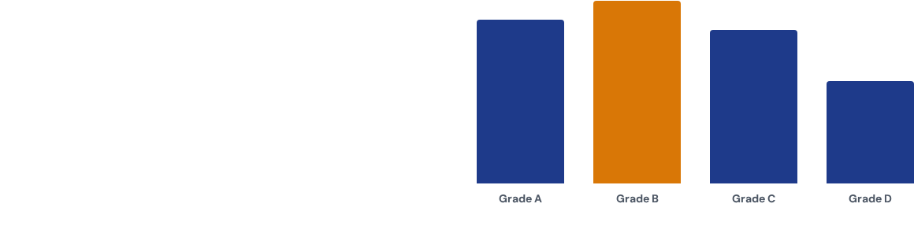
Risk Segmentation by Credit Grade
Grade B accounts for the largest revolving balance (₹161.3M), indicating a core concentration in moderate-risk, high-volume territory.
Grades F and G are kept at minimal levels (₹6.5M), demonstrating effective mitigation of extremely high-risk exposure.

Slide 6

Verification: Can we trust the Borrower?
Verification Breakdown:
•
45% Fully Verified (Core Trust)
•
23% Source Verified (Documentation)
45%
•
32% Not Verified (High Risk Area)
Management recommendation: Mandatory verification for any Grade C+ applications over ₹25k.

Slide 7
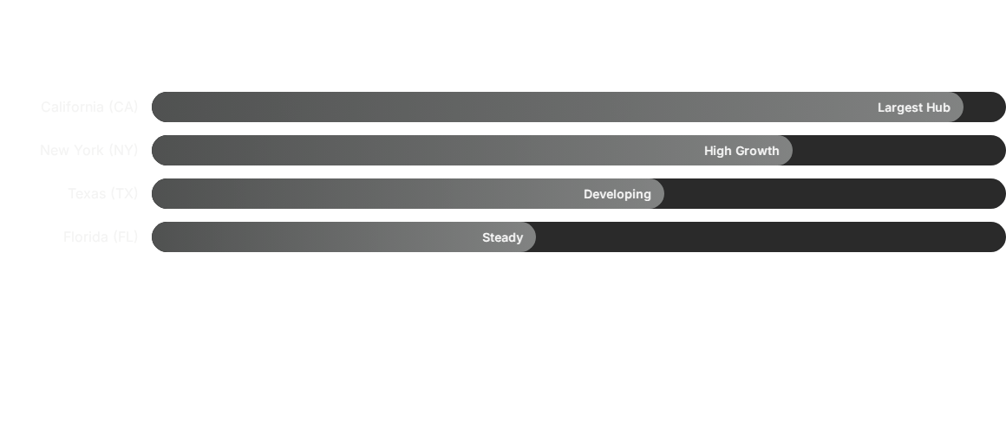

Geographical Market Concentration
Insight: California (CA) is our biggest market. By focusing our marketing and branch operations in these high-volume states, we can maximize our profit with lower effort.

Slide 8
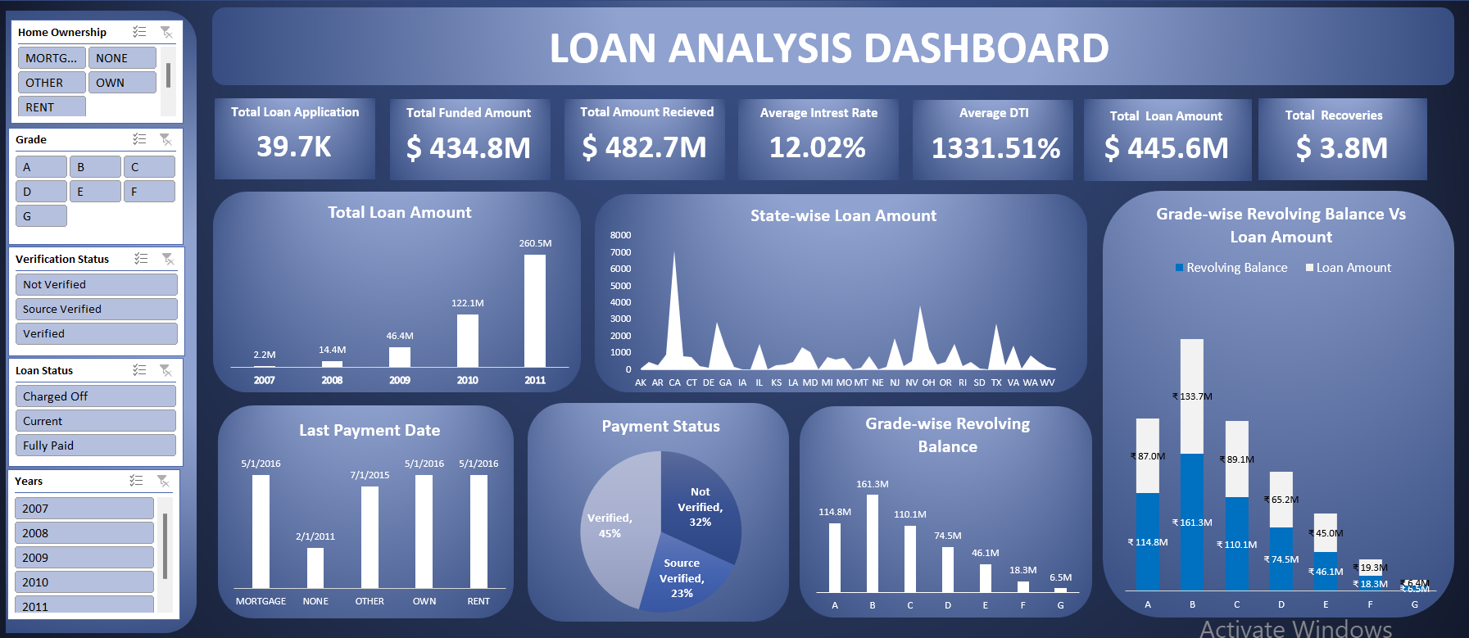

Excel Dashboard
Developed an interactive Excel dashboard to analyze loan applications, funded amounts, repayments, interest rates, and borrower grades. Utilized pivot tables, slicers, and data visualization techniques to track loan performance, payment status, and state-wise distribution, enabling clear financial insights and decision-making.

Slide 9
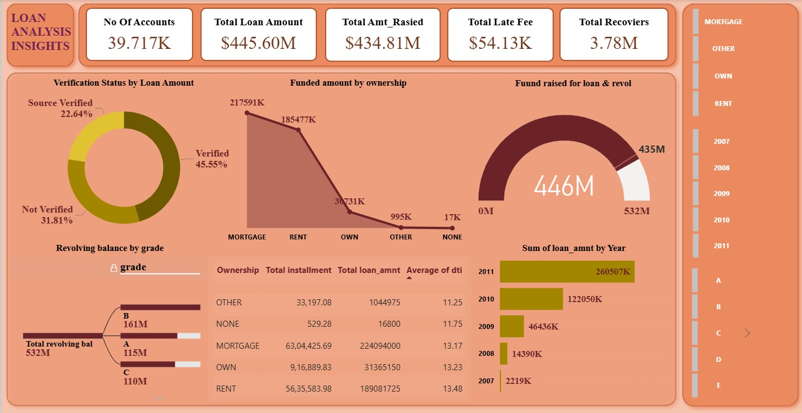

Power Bi Dashboard
Developed an interactive Power BI dashboard to analyze total loan amount, funded amount, accounts, late fees, and recoveries. The dashboard provides insights by grade, sub-grade, employee length, verification status, home ownership, and monthly trends, enabling effective monitoring of loan performance and risk distribution.

Slide 10
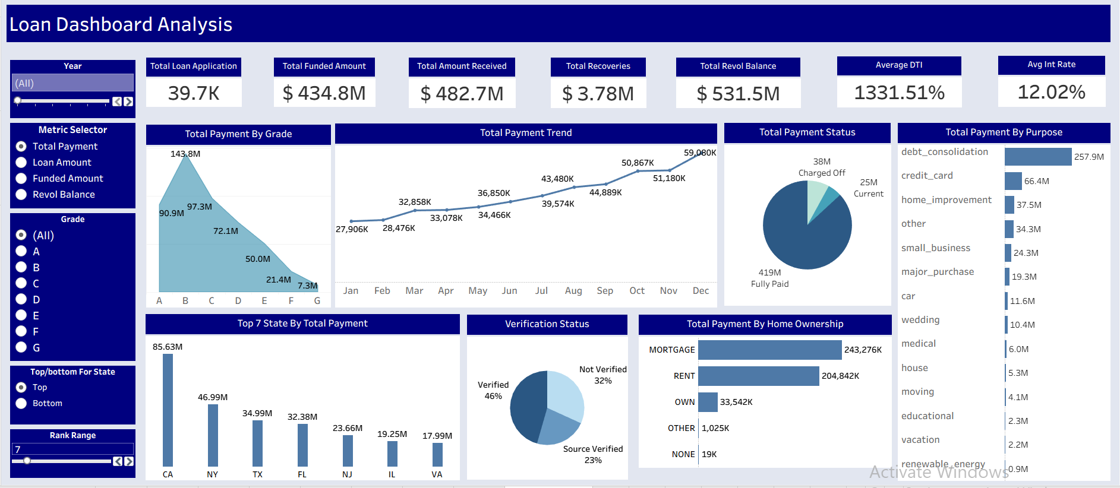

Tableau Dashboard
Designed an interactive Tableau dashboard to monitor loan performance, including total payments, funded amounts, recoveries, and borrower grades. Integrated filters and KPIs to analyze payment trends, verification status, loan purpose, and state-wise distribution, enabling dynamic and data-driven financial insights.

Slide 11
Key Project Gains & Verdict
₹48M Profit Visibility: Confirmed high-margin yield after accounting for funded vs. received capital.
Recovered Capital: ₹3.8M successfully tracked and identified back into the portfolio.
Risk Awareness: Pinpointed the 32% unverified segment for mandatory document upgrading.
Decision Speed: Created a scalable dashboard framework ready for 2012+ expansion data.

